Slide 1

AI Architecture Design
COURSE INSTRUCTOR
Eng. Sameh Amin
AI Architecture Design Course, for AI, ML and software engineers on designing production-grade AI systems: LLM, RAG and agent architectures, security, governance and evaluation, with enterprise case studies.
Unifonic | MLOps MENA
18th October 2026

Slide 2
Table of Contents
1. Architecture Views, Steps and Process
2. AI System Building Blocks (data pipelines, training, fine-tuning, …)
3. LLM & RAG Architecture
4. Agentic AI Architecture
5. Production Readiness (Security, Governance, Evals)
6. Enterprise Case Studies

Slide 3
What this course is
General architecture method, applied to AI systems.
AI design best practices.
Practical sessions with enterprise case studies (telecom, e-commerce, government) for each session.
Paying attention to functional and non-functional quality attributes, to be ready for production.
Target audience: Senior Engineers from any specialization (BE, FE, AI, …), EMs, TLs, up to CTOs, semi-technical people, PMs and similar.

Slide 4
What this course is not
It’s not a product/business ideas course, and not for business-only people.
This course is not a machine learning or data science course.

Slide 5
Course Setup & Logistics
UML tool: Draw.io, Mermaid, or paper!
Any OS.
Wiki tool: Confluence, Obsidian, MS Word, …
Agentic coding IDE (optional).
Excel (MS or libreoffice).

Slide 6
The Architect personality & culture
Humble: puts the best solution ahead of his own idea
Curious: keeps learning new technologies and domains
Pragmatic: picks the simplest design that meets the requirements (mvp)
Technology agnostic: isolated from his preferred tech.
Trade-off thinker: no design is perfect, every choice has a cost
Strong communicator (viewpoints): explains the same design to engineers and executives
Collaborative: listens first, influences without authority
Accountable: owns decisions and their consequences (POC, Skeleton)

Slide 7
The Project, The Business Requirements

Slide 8
Real-world project: Marketing Automation with AI & Agents
Functional use cases
  Homepage / Products page Personalization. (feature stores).
  Next-best action.
  New users (cold start).
  Agentic Marketing - Campaign Automation.
KPIs / Objectives (L2 connected to goals)
  Increase the sales take-rate by 80%.
  Increase CSAT to 70%.
  Feedback loop.
Non-functional use cases
  Latency (real-time, near real-time, batch).
  Scalability (number of users, peak campaigns).
  Explainability and business control.
  Security & Compliance requirements? Privacy (PDPL)?

Slide 9
The Business Requirements
Stakeholders / Personas?
Use cases assessment (the planning call).
Should you provide the timelines now? Ready for implementation vs spikes.
Should we stop the AD till all spikes completed?
Closing the gaps, questions and inquiries (1–n rounds).

Slide 10
Architecture Views, Steps and Process

Slide 11
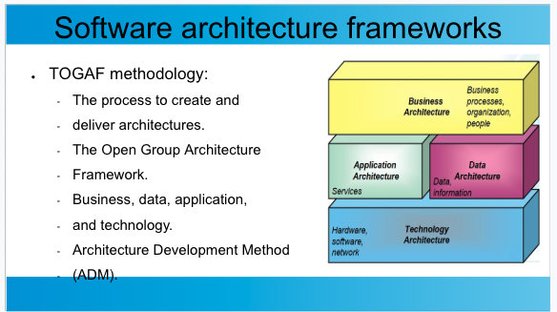
Architecture Frameworks (TOGAF)

Slide 12
Architecture Frameworks (Zachman)
Focuses on what to create and deliver.
Maps six fundamental questions (what, how, where, who, when, and why) to six perspectives (planner, owner, designer, builder, implementer, and user).

Slide 13
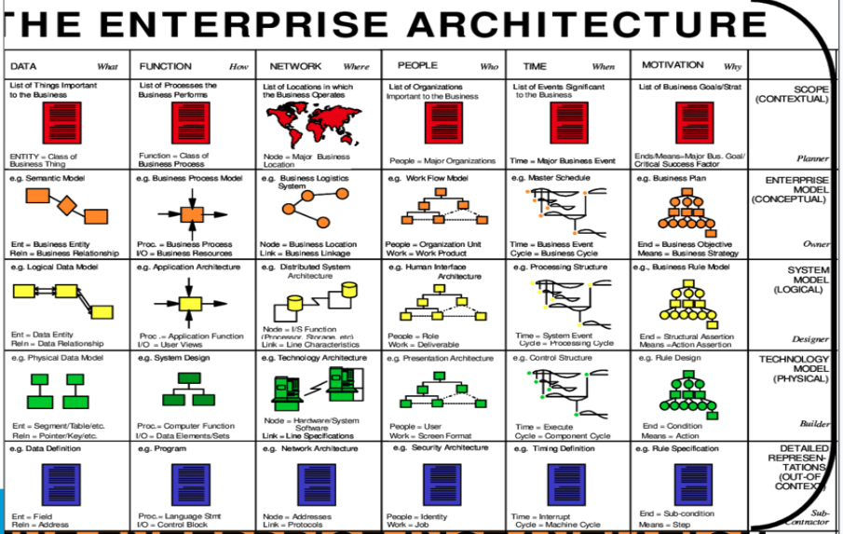

Slide 14
The C4 Framework
By Simon Brown: “maps of your code”.
Four zoom levels, big picture to code.
One level per audience: execs to devs.
Notation-free: boxes, lines, labels.
Extra views: landscape, dynamic, deployment.
Tools: Structurizr, Mermaid, draw.io.
1. System Context
People, the system, external systems
2. Containers
Apps, APIs, databases, queues
3. Components
Modules inside one container
4. Code (optional)
Classes, ERD, sequence

Slide 15
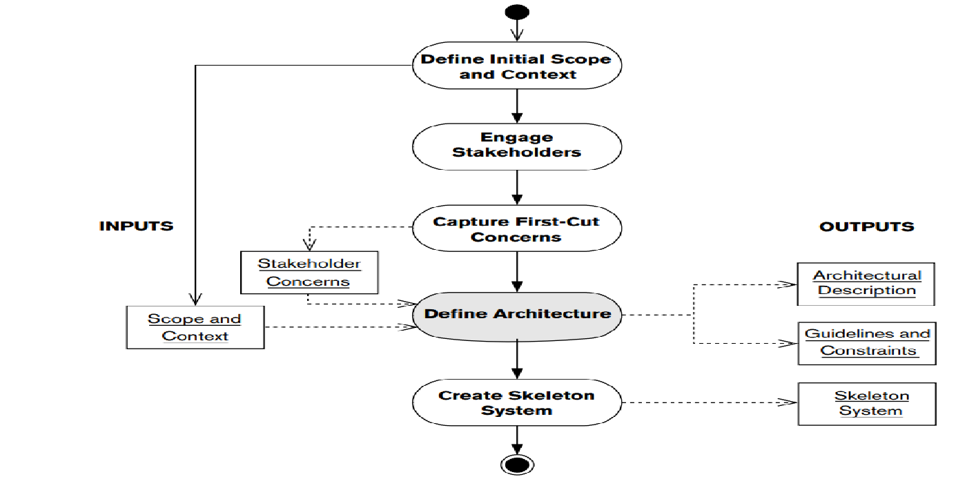
Architecture development process

Slide 16
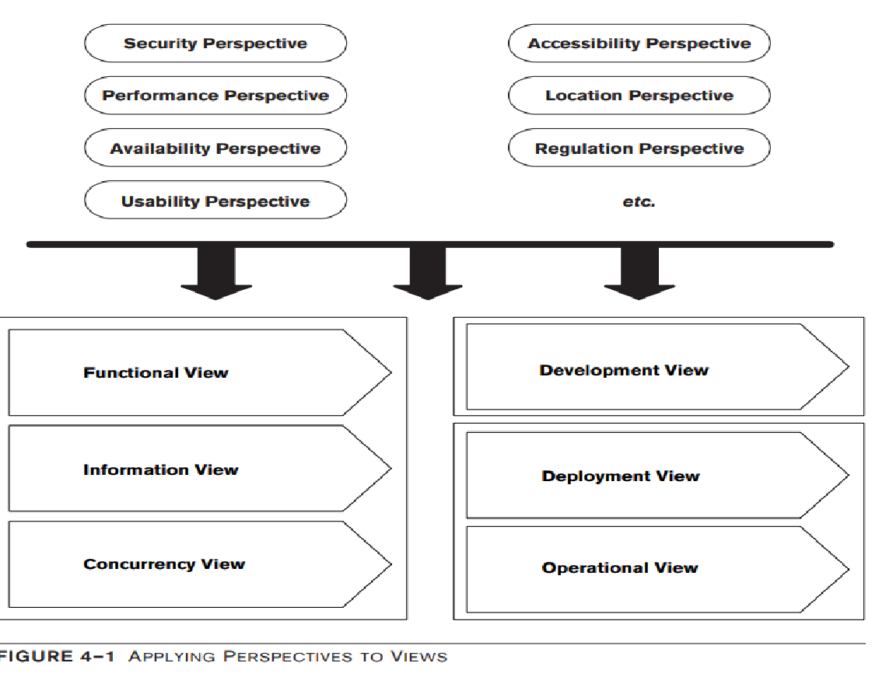
Architectural Perspectives (Quality attributes)

Slide 17
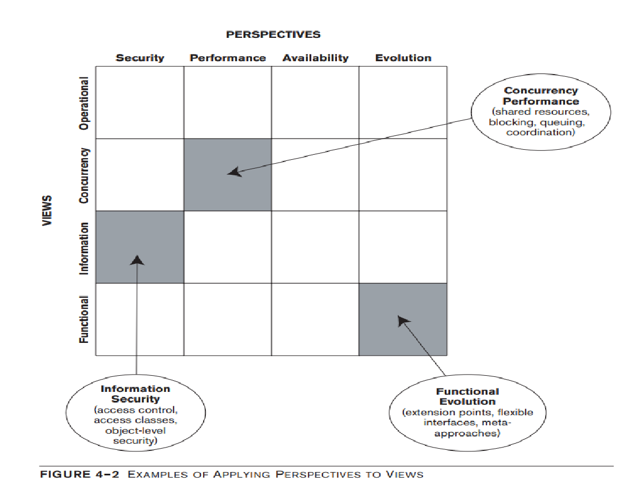
Applying Perspectives to Views

Slide 18
Architecture & Agile
Project level.
Epic level.
Story level.
Research/spike level.

Slide 19
Architecture description

Slide 20
Architecture Intro and facts
Problem statement/pain points.
Goals/non-goals, Solution Assumptions.
As-is Architecture, Explore the Enterprise Architecture.
Architecture principles, key decisions and trade-offs.
Assessment.
Priorities.

Slide 21
High-Level Design
Applying C1 - Context Viewpoint
  Systems Boundaries.
  Source systems and destination systems.
  Components Breakdown.
Applying C2 view - Deployment viewpoint
  Containers.
  Nodes.
  Ports and protocols.
  Authentication/authorization.
  Networking layer (inbound/outbound connections).
  Capacity planning (Nodes, pods, DRs, CPUs, GPUs).

Slide 22
Information viewpoint / data pipelines
C2 view.
Data pipelines - data flows.
Messaging and queues.
Data velocity (real-time, near real-time, batch).
Data size (load/frequency).
Data quality: is any preprocessing required?
Data Retention policy/backups/replications.
Data sources and ownership (CRM, events, CDP, Data lakes/warehouses Vector DB, SQL DBs).
Data classification and privacy (PII, PDPL, consent).

Slide 23
Concurrency Viewpoint
C2 view - Sequence diagram / use case.
Examples and questions to extract concurrency requirements and gaps
  Processes, threads and workers mapped to containers.
  Sync vs async interactions (API calls, events, queues).
  Shared state and resources (locks, transactions, caching).
  Parallelism and scaling (worker pools, partitions, autoscaling).
  Rate limits (LLM/API quotas, throttling).
  Timeouts, retries and failure handling (circuit breaker, DLQ [dead-letter queue]).
  Scheduling and orchestration (cron, batch jobs, workflows).

Slide 24
Operational viewpoint
Observability layer.
  Grafana: resource utilization.
  Loki: logging aggregation.
  Prometheus: Alerts and OpenTelemetry metrics.
  Kibana: dashboard & visualization, analytics.
MLOps layer
  Langfuse: AI logging and evaluations.
  MLflow: Model registry and lifecycle, experiment tracking, version control.
  Airflow, Flink, Prefect: Data preprocessing, schedulers and transformation.
  Model serving
    KServe: Kubernetes-native model serving, autoscaling and canary rollouts.
    BentoML: package models as APIs, easy containerized deployment.
    vLLM: high-throughput LLM inference engine (PagedAttention, continuous batching).

Slide 25
Architecture Governance

Slide 26
Architecture Governance key points
Always connect and relate to business goals.
Principles and standards: approved technologies, patterns, reference architectures.
Architecture Review Board (ARB): reviews designs at key gates, approves exceptions.
Decision records (ADRs): context, options, trade-offs, owner.
Light-touch automation: guardrails over gates, automated checks in CI/CD (optional).

Slide 27
Architecture & Agentic Coding

Slide 28
Agentic Architecture
Claude as an Architect.
Skills needed.
Swarm of agents.

Slide 29
Assignment

Slide 30
AI System Building Blocks

Slide 31
AI System Building Blocks
Data pipelines and feature stores
Model layer (foundation, fine-tuned, classical ML)
Training vs inference infrastructure
Serving, APIs and orchestration
MLOps / LLMOps and observability
Real-world use case.
Assignment.

Slide 32
LLM & RAG Architecture
LLM selection and hosting (API vs self-hosted)
Prompting and context management
Embeddings and vector databases
RAG pipeline (chunking, retrieval, re-ranking)
Advanced patterns (hybrid search, GraphRAG)
Real-world use case.
Assignment.

Slide 33
Agentic AI Architecture
Agent fundamentals and design patterns (ReAct, planner-executor)
Tools, function calling and MCP
Memory and state management
Multi-agent orchestration
Human-in-the-loop
Guardrails
Real-world use case.
Assignment.

Slide 34
Security, Governance, Evals
AI threat modeling (prompt injection, data leakage)
Guardrails and access control
Governance, compliance and responsible AI
Evaluation methods (offline, LLM-as-judge, human)
Production monitoring and observability
Real-world use case.
Assignment.

Slide 35
Capstone Project
Applied AI in related industries (telecom, e-commerce, government, …)
Lessons learned and trade-offs
Capstone presentation and deliveries.

Slide 36
W1 mini projects
Mini project: governance pack for the Marketing Automation with AI & Agents system.
Write 5 architecture principles, each linked to a business goal.
Write 3 ADRs (Architecture Decision Records), e.g. API vs self-hosted LLM, vector DB choice, real-time vs batch: options, trade-offs, decision.
Build an ARB (Architecture Review Board) checklist: security, privacy (PDPL), evals, cost, human oversight.
Add one automated guardrail (CI check or agent reviewing a design against your principles) (optional).
Deliver: one wiki page and one draw.io diagram, max 2 pages.

